Slide 1
SPATIAL FILTERING

Slide 2
SPATIAL FILTERING
The word “filtering” has been borrowed from the frequency domain
Filter term in “Digital image processing” is referred to the subimage
There are others term to call subimage such as mask, kernel, template, or window
The value in a filter subimage are referred as coefficients, rather than pixels.
The concept of filtering has its roots in the use of the Fourier transform for signal processing in the so-called frequency domain.
Spatial filtering term is the filtering operations that are performed directly on the pixels of an image

Slide 3
SPATIAL FILTERING
Spatial filtering is defined by:
A neighborhood
An operation that is performed on the pixels inside the neighborhood
Typically, the neighborhood is rectangular and its size is much smaller than that of f(x,y) - e.g., 3x3 or 5x5
output image

Slide 4
SPATIAL FILTERING
The process consists simply of moving the filter mask from point to point in an image.
At each point (x,y) the response of the filter at that point is calculated using a predefined relationship

Slide 5
SPATIAL FILTERING: Simple Operations
Simple neighbourhood operations example:
Min: Set the pixel value to the minimum in the neighbourhood
Max: Set the pixel value to the maximum in the neighbourhood

Slide 6
SPATIAL FILTERING
The result is the sum of products of the mask coefficients with the corresponding pixels directly under the mask
Pixels of image
f(x-1,y-1)
w(-1,-1)
f(x-1,y)
w(-1,0)
f(x-1,y+1)
w(-1,1)
w(-1,-1)
w(-1,0)
w(-1,1)
f(x,y-1)
w(0,-1)
f(x,y)
w(0,0)
f(x,y+1)
w(0,1)
w(0,-1)
w(0,0)
w(0,1)
f(x+1,y-1)
w(1,-1)
f(x+1,y)
w(1,0)
f(x+1,y+1)
w(1,1)
w(1,-1)
w(1,0)
w(1,1)

Slide 7
SPATIAL FILTERING
The coefficient w(0,0) coincides with image value f(x,y), indicating that the mask is centered at (x,y) when the computation of sum of products takes place.
For a mask of size [m x n], we assume that m=2a+1 and n=2b+1, where a and b are nonnegative integer. Then m and n are odd.

Slide 8
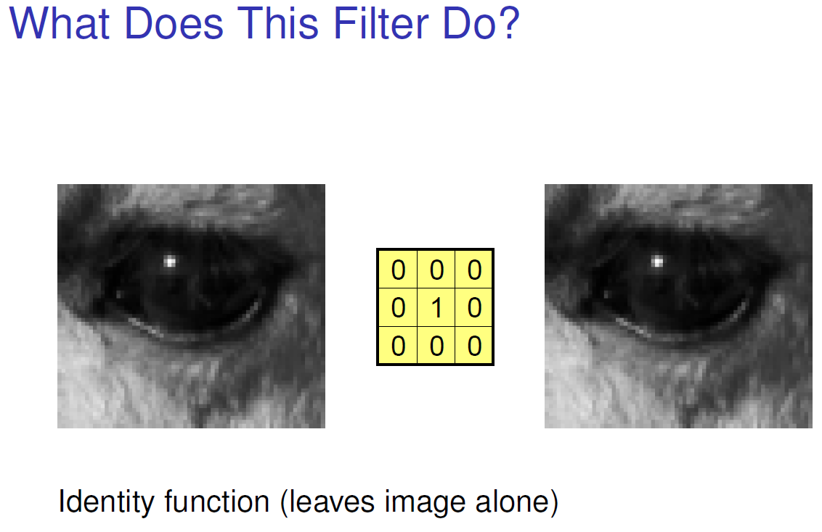
SPATIAL FILTERS

Slide 9
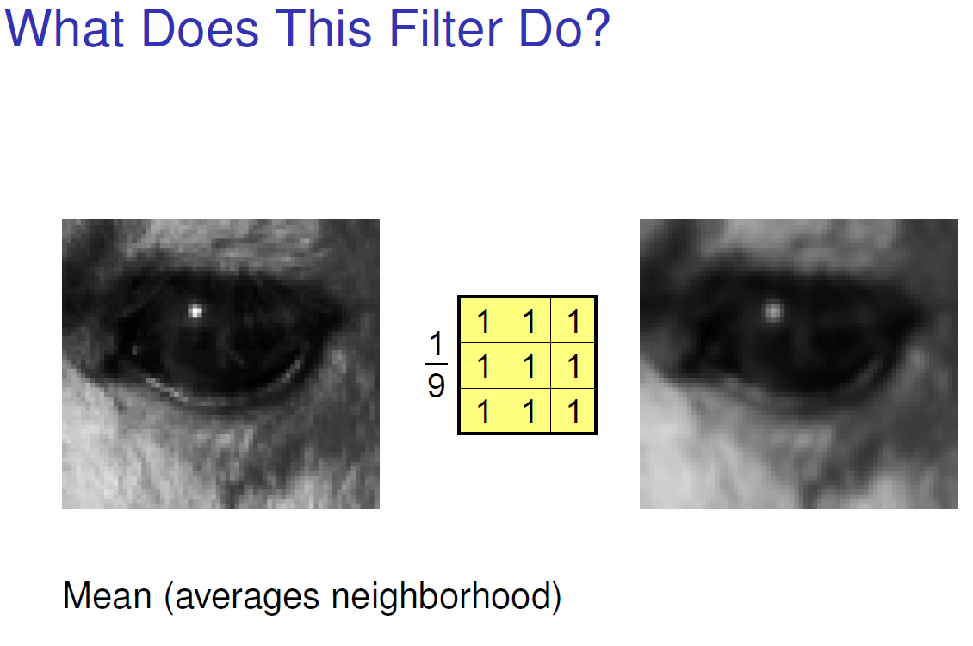
SPATIAL FILTERS

Slide 10
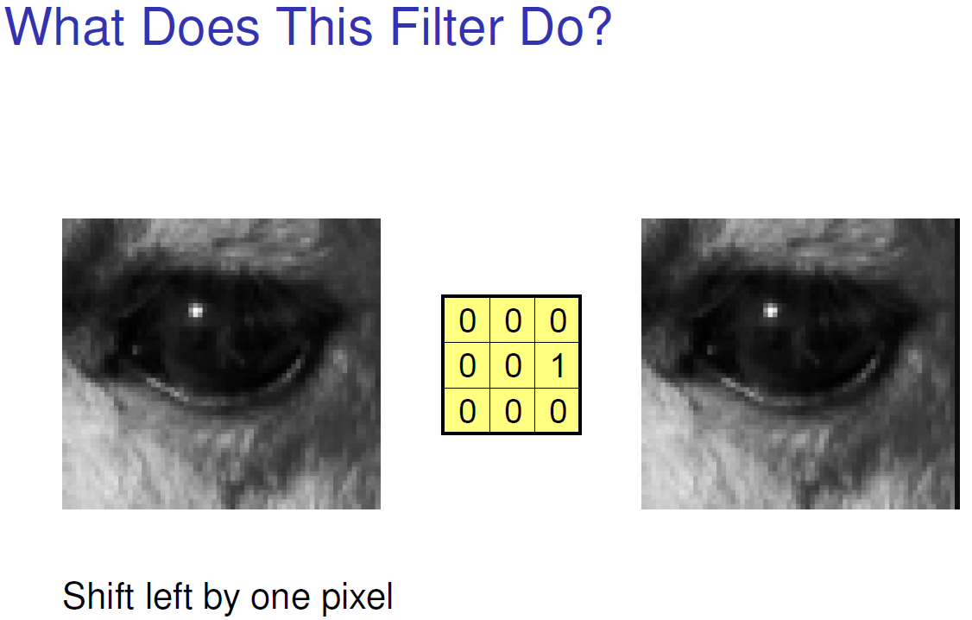
SPATIAL FILTERS

Slide 11
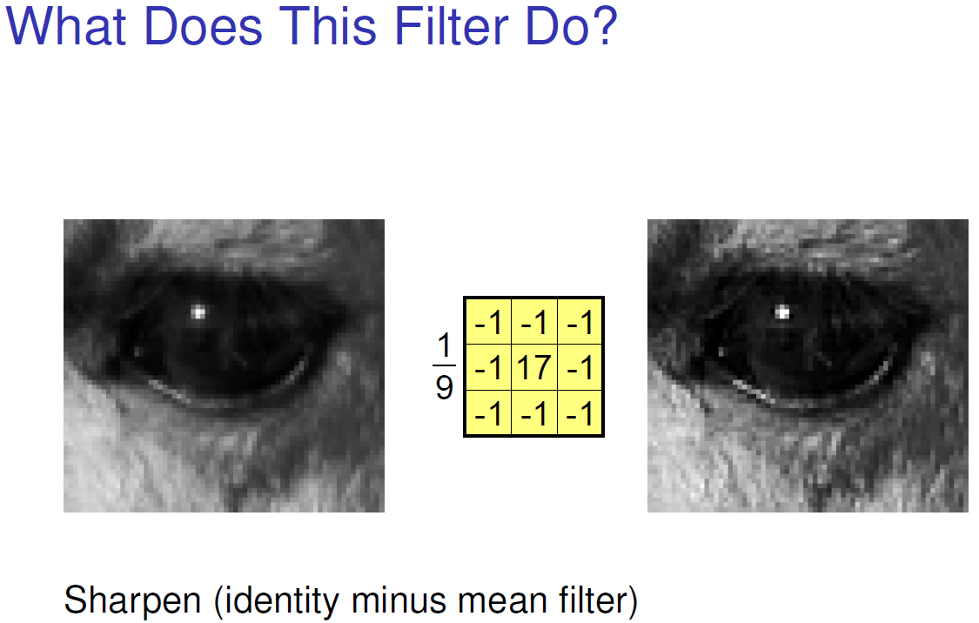
SPATIAL FILTERS

Slide 12
LINEAR FILTERING : CONVOLUTION
The process of linear filtering similar to a frequency domain concept called “convolution”
w₁
w₂
w₃
w₄
w₅
w₆
w₇
w₈
w₉

Slide 13
LINEAR Vs NONLINEAR
Linear Filtering
Correlation
Convolution
Nonlinear spatial filters also operate on neighborhoods, and the mechanics of sliding a mask past an image are the same as was just outlined.
The filtering operation is based conditionally on the values of the pixels in the neighborhood under consideration

Slide 14
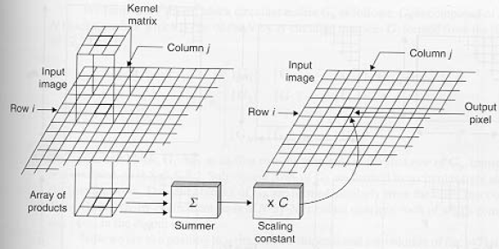
Correlation
w(i,j)
Output
Image
f(i,j)

Slide 15
Correlation
Often used in applications where we need to measure the similarity between images or parts of images
(e.g., pattern matching).

Slide 16
Convolution
Similar to correlation except that the mask is first flipped both horizontally and vertically.
Note: if w(x,y) is symmetric, that is w(x,y)=w(-x,-y), then convolution is equivalent to correlation!

Slide 17
Correlation
Correlation:
Convolution:

Slide 18
Handling Pixels Close to Boundaries
Origin
x
e
e
e
e
e
e
e
y
Image f (x, y)

Slide 19
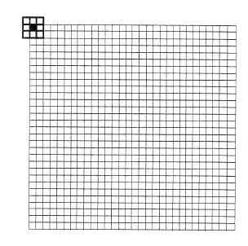
Handling Pixels Close to Boundaries
pad with zeroes

Slide 20
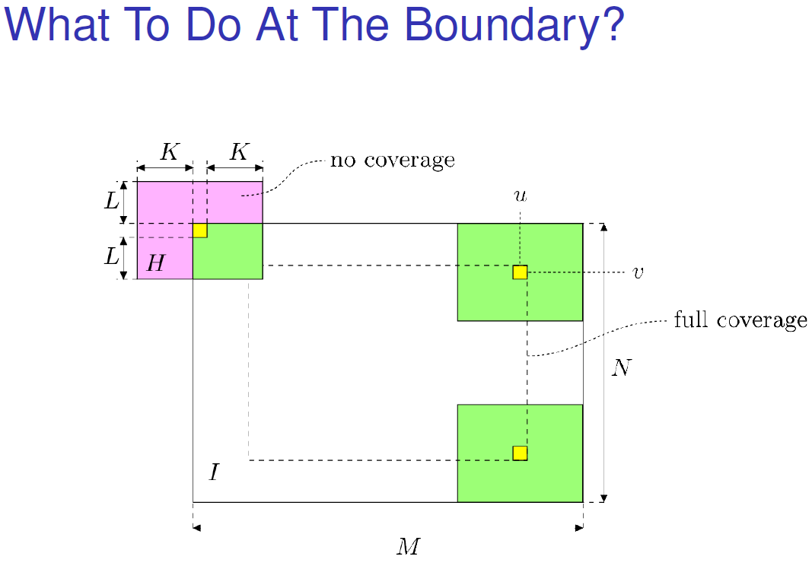
Handling Pixels Close to Boundaries

Slide 21
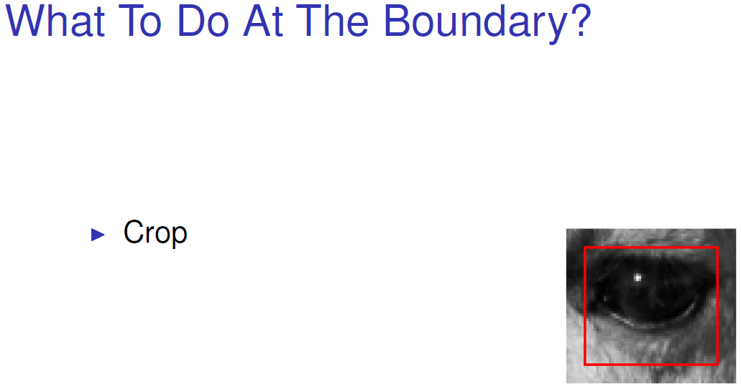
Handling Pixels Close to Boundaries

Slide 22
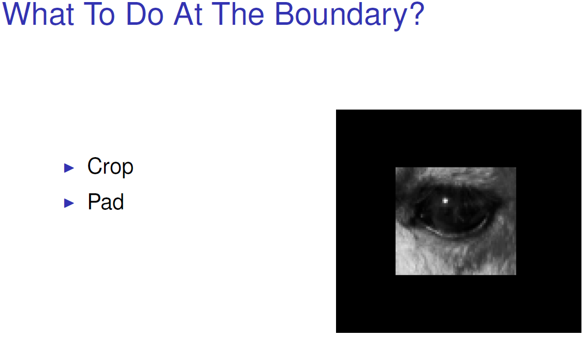
Handling Pixels Close to Boundaries

Slide 23
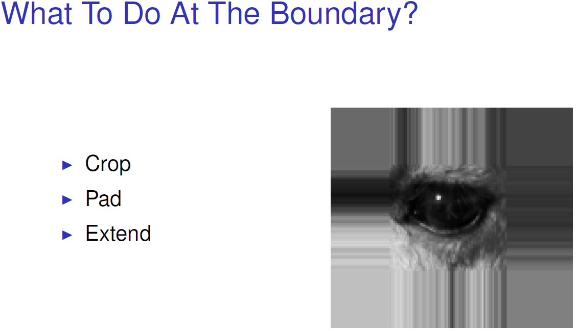
Handling Pixels Close to Boundaries

Slide 24
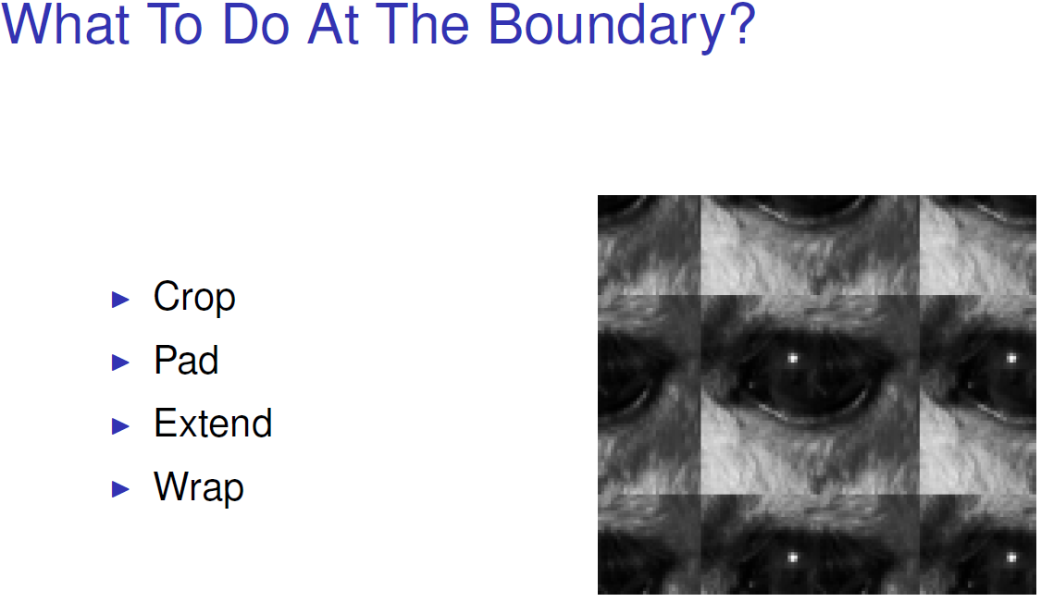
Handling Pixels Close to Boundaries

Slide 25
Smoothing Spatial Filters
Smoothing filters are used for blurring and for noise reduction.
Blurring is used in preprocessing steps, such as removal of small details from an image prior to object extraction, and bridging of small gaps in lines or curves
Noise reduction can be accomplished by blurring
There are 2 way of smoothing spatial filters
Smoothing Linear Filters (averaging filters)
Simply the average of the pixels contained in the neighborhood of the filter mask.
Order-Statistics Filters

Slide 26
Smoothing Linear Filters
1
1
1
1
2
1
1
1
1
2
4
2
1
1
1
1
2
1
Standard average
Weighted average
1
1
1
1
1
1
1
1
1
1
1
1
1
1
1
1
1
1
1
1
1
1
1
1
1

Slide 27
Smoothing Spatial Filters
The general implementation for filtering an MxN image with a weighted averaging filter of size mxn is given by the expression

Slide 28
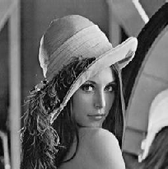
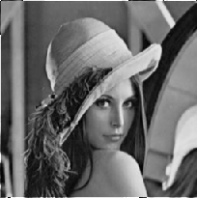
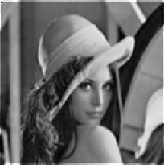

Smoothing Linear Filters
Original Image
[3x3]
[5x5]
[7x7]

Slide 29
Order-Statistics Filters
Order-statistics filters are nonlinear spatial filters whose response is based on ordering (ranking) the pixels contained in the image area encompassed by the filter, and then replacing the value of the center pixel with the value determined by the ranking result. Best-known “median filter”
Corp region of neighborhood
Sort the values of the pixel in our region
In the MxN mask the median is MxN div 2 +1
10
15
20
20
100
20
20
20
25
10, 15, 20, 20, 20, 20, 20, 25, 100
5th

Slide 30
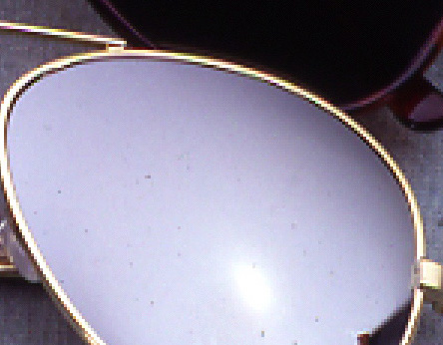
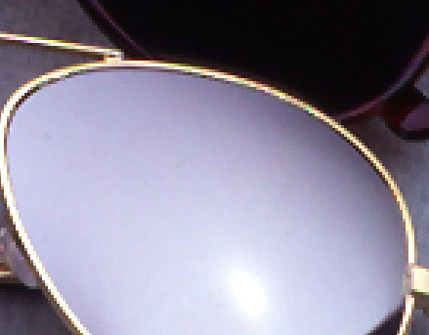
Median Filter
Noise from Glass effect
Remove noise by median filter

Slide 31
Sharpening Spatial Filters
The principal objective of sharpening is to highlight fine detail in an image or to enhance detail that has been blurred, either in error or as an natural effect of a particular method of image acquisition.
The image blurring is accomplished in the spatial domain by pixel averaging in a neighborhood.
Since averaging is analogous to integration.
Sharpening could be accomplished by spatial differentiation.
Sharpening Images with
Constant gray level(flat segments),
At the onset and end of discontinuities(step and ramp discontinuities), and
Along gray-level ramps.
These types of discontinuities can be noise points, lines, and edges.

Slide 32
Definition for a first derivative
Must be zero in flat segments
Must be nonzero at the onset of a gray-level step or ramp; and
Must be nonzero along ramps.
A basic definition of the first-order derivative of a one-dimensional function f(x) is

Slide 33
Definition for a Second derivative
Must be zero in flat areas;
Must be nonzero at the onset and end of a gray-level step or ramp;
Must be zero along ramps of constant slope
A basic definition of the second-order derivative of a one-dimensional function f(x) is

Slide 34

Gray-level profile
0
0
0
1
2
3
2
0
0
2
2
6
3
3
2
2
3
3
0
0
0
0
0
0
7
7
6
5
5
3
7
6
5
4
3
2
1
0

Slide 35
Derivative of image profile
0 0 0 1 2 3 2 0 0 2 2 6 3 3 2 2 3 3 0 0 0 0 0 0 7 7 6 5 5 3
0 0 1 1 1-1-2 0 2 0 4-3 0-1 0 1 0-3 0 0 0 0 0-7 0-1-1 0-2
first
0-1 0 0-2-1 2 2-2 4-7 3-1 1 1-1-3 3 0 0 0 0-7 7-1 0 1-2
second

Slide 36
Definition for a Second derivative
The 1st-order derivative is nonzero along the entire ramp, while the 2nd-order derivative is nonzero only at the onset and end of the ramp.
The response at and around the point is much stronger for the 2nd- than for the 1st-order derivative
1st make thick edge and 2nd make thin edge

Slide 37
The Laplacian (2nd order derivative)
Shown by Rosenfeld and Kak[1982] that the simplest isotropic derivative operator is the Laplacian is defined as
f(x-1,y)
f(x,y)
f(x+1,y)
f(x,y-1)
f(x,y)
1
f(x,y+1)
1
-4
1
1

Slide 38
The Laplacian (2nd order derivative)
0
1
0
1
1
1
1
-4
1
1
-8
1
0
1
0
1
1
1
1
0
1
0
-4
0
1
0
1

Slide 39
The Laplacian (2nd order derivative)
0
-1
0
-1
-1
-1
-1
4
-1
-1
8
-1
0
-1
0
-1
-1
-1
-1
0
-1
0
4
0
-1
0
-1
If the center coefficient is negative
Where f(x,y) is the original image
is Laplacian filtered image
g(x,y) is the sharpen image

Slide 40
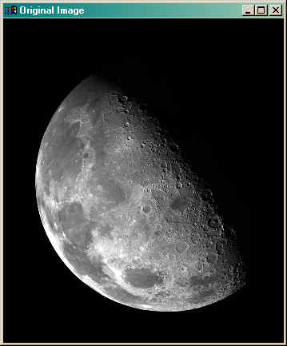
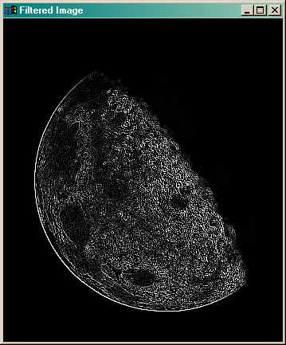
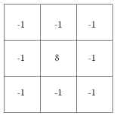
Implementation
Filtered = Conv(image,mask)

Slide 41
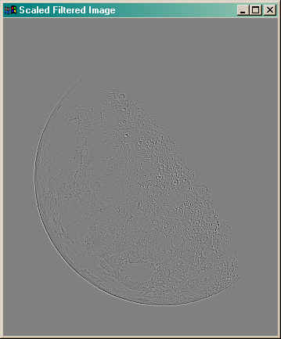
Implementation
filtered = filtered - Min(filtered)
filtered = filtered * (255.0/Max(filtered))

Slide 42
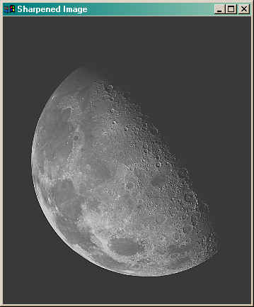
Implementation
sharpened = image + filtered
sharpened = sharpened - Min(sharpened )
sharpened = sharpened * (255.0/Max(sharpened ))

Slide 43
Algorithmic Simplification
Using Laplacian filter to original image
And then add the image result from step 1 and the original image
Apply two step to be one mask
0
-1
0
-1
-1
-1
-1
5
-1
-1
9
-1
0
-1
0
-1
-1
-1

Slide 44
Unsharp masking
A process to sharpen images consists of subtracting a blurred version of an image from the image itself. This process, called unsharp masking, is expressed as
Where denotes the sharpened image obtained by unsharp masking, and is a blurred version of

Slide 45
High-boost filtering
A high-boost filtered image, f_{hb} is defined at any point (x,y) as
If we choose to use the Laplacian, then we know f_{s}(x,y)
This equation is applicable general and does not state explicitly how the sharp image is obtained
If the center coefficient is negative
If the center coefficient is positive
0
-1
0
-1
-1
-1
-1
A+4
-1
-1
A+8
-1
0
-1
0
-1
-1
-1

Slide 46
The Gradient (1st order derivative)
First Derivatives in image processing are implemented using the magnitude of the gradient.
The gradient of function f(x,y) is
The magnitude of this vector is given by
G_{x}
-1
1
This mask is simple, and no isotropic. Its result only horizontal and vertical.
1
G_{y}
-1

Slide 47
Robert’s Method
The simplest approximations to a first-order derivative that satisfy the conditions stated in the previous slide are
These mask are referred to as the Roberts cross-gradient operators.
G_{x} = (z₉-z₅) and G_{y} = (z₈-z₆)
z₁
z₂
z₃
-1
0
0
-1
z₄
z₅
z₆
0
1
1
0
z₇
z₈
z₉

Slide 48
Sobel’s Method
Mask of even size are awkward to apply.
The smallest filter mask should be 3x3.
The difference between the third and first rows of the 3x3 mage region approximate derivative in x-direction,
The difference between the third and first column approximate derivative in y-direction.
-1
-2
-1
-1
0
1
0
0
0
-2
0
2
1
2
1
-1
0
1

Slide 49
Linear Spatial Filtering Implementation using MATLAB
The toolbox implements linear spatial filtering using function imfilter, with the following syntax:
g = imfilter (f, w, filtering_mode, boundary_option, size_option);
This function filters the multidimensional array f (image) with the multidimensional filter w (filter mask). The result g (filtered image) has the same size and class as f.
Each element of the output g is computed using double-precision floating point.

Slide 50
Linear Spatial Filtering Implementation using MATLAB
g = imfilter (f, w, filtering_mode, boundary_option, size_option);
Filtering_mode:
Option Description
--------- ---------------
‘Corr’ imfilter performs multidimensional filtering using correlation (default option)
‘Conv’ filtering is done using convolution
Boundary_option:
Option Description
--------- ---------------
X input array values outside the bounds of the array are implicitly assumed to have the value x, when no boundary option is specified, imfilter uses x = 0 (zero padding)
Size_options:
Option Description
--------- ---------------
‘Same’ the output image is the same size as the input image, this is the default
‘full’ the output image is the full filtered result.

Slide 51
END

